Slide 1

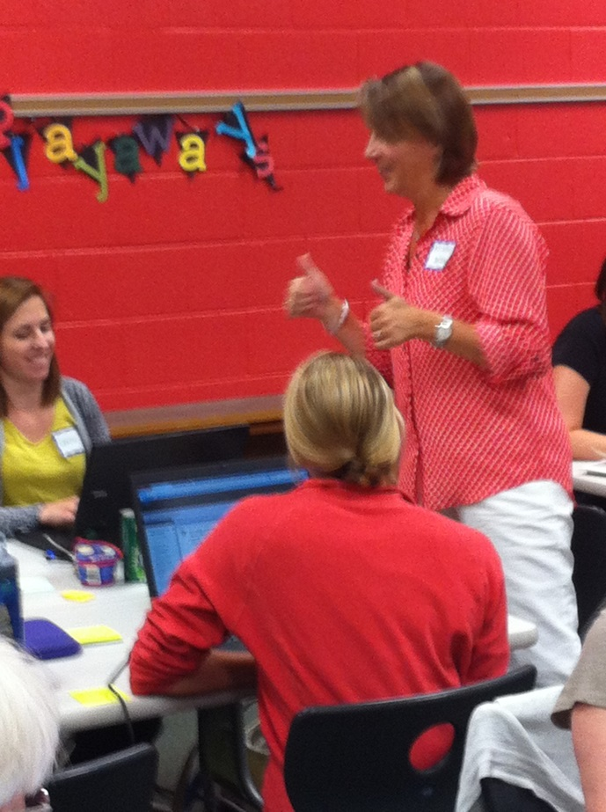
Digital and Technology Integration

Slide 2
Expected Impacts
“All Albemarle County Public Schools students will graduate having actively mastered the lifelong learning skills they need to succeed as 21st century learners, workers and citizens.”
Albemarle County Public Schools Strategic Goal

Slide 3
The Curriculum Integration work will lead the division in accomplishing this goal by achieving the following….
…move from teacher centered to learner centered with more personalize learning
…focus will shift from teachers to students; teachers become facilitators
…project-based and problem-based learning will be the basis of collaborative learning

Slide 4
The Curriculum Integration work will lead the division in accomplishing this goal by achieving the following….
…improvement in critical thinking and problem solving by using research working both collaboratively and individually
…improve communication skills
…improvements in digital literacy and digital citizenship

Slide 5
Readiness Preparation
Developed a shared vision, mission and strategic plan and created a logic map and a year-one project charter
School Readiness Surveys for all secondary schools
Fit-Gap Analysis – Determined gap between current and desired states
Conducted site surveys (wireless infrastructure, internet access, physical facilities
Developed device roll-out plan
Professional Development
Curriculum development
Communication Plan

Slide 6
2014 – 2015 Pilot
Middle Schools
Burley – 6th, 7th, & 8th
Henley – 7th
Sutherland – 7th
Walton – 6th, 7th, & 8th
High Schools
Albemarle – 9th
Monticello – 9th & 10th
Murray – 9th, 10th, 11th, & 12th
Western Albemarle – 9th

